Slide 1
ICN MLI
January 13-15, 2015
Machine Learning Basics
Daniel Dahlmeier
https://github.wdf.sap.corp/I073941/ml-bootcamp
Image credits: bestfreejpg.com

Slide 2
What is Machine learning?

Slide 3
Machine learning: class of methods that enable computers to learn a solution to a task without being explicitly programmed.

Slide 4
Learn: approximate a function between some input x and output y from empirical data
y = h(x)
predictor
output
input

Slide 5
Machine learning is a “general purpose” technology.
Same algorithms can be applied to very different use cases.

Slide 6




Input: your purchase history
Output: which article will you buy next
Input: your query and search history
Output: which ads are relevant to you
Input: your CV and a job description
Output: is candidate a match for this job
Input: a financial transaction
Output: is the transaction fraud

Slide 7
Machine learning and friends
AI
Language
Statistic
Vision
…
◄ builds on
Machine Learning
◄ uses
Optimization
Robotic

Slide 8

It is not new..

Slide 9
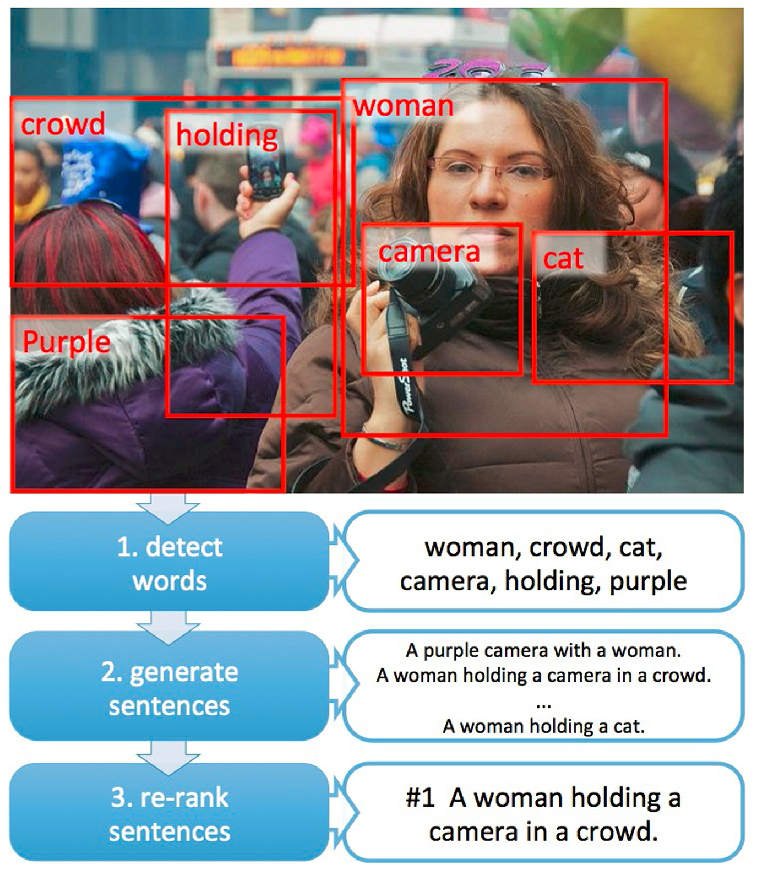
.. but now it
actually works
blogs.microsoft.com

Slide 10
Better computers
What is the
difference now?
Huge Datasets
New
Algorithms

Slide 11
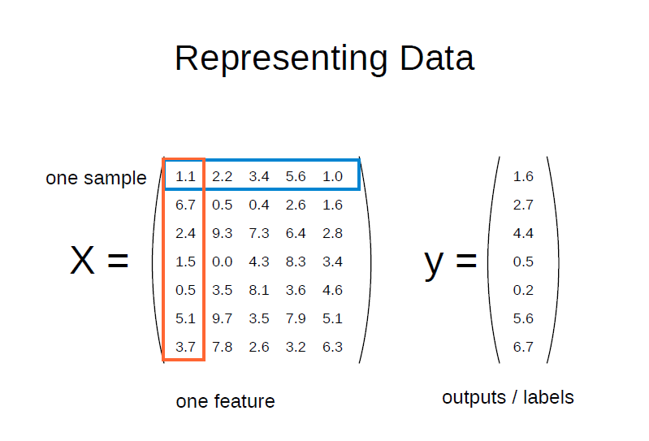

Slide 12
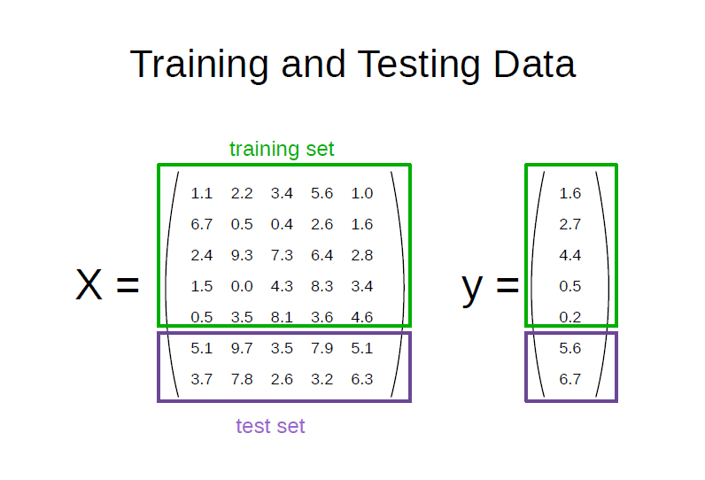

Slide 13
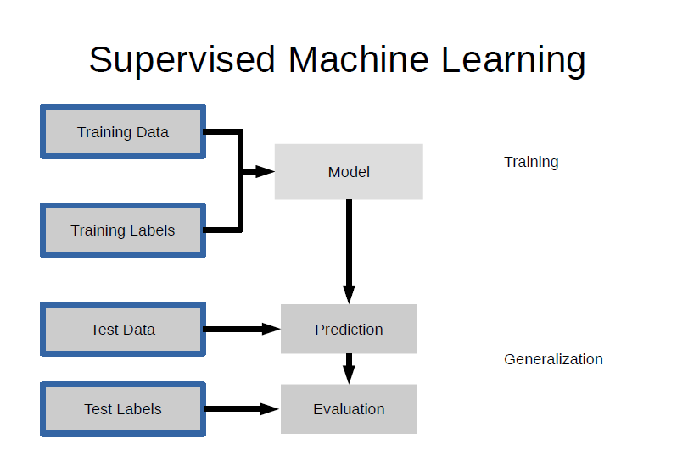

Slide 14
Supervised learning: regression
We have (x, y) examples for training
y is continuous
Model: y = w1*x + w0
y
Parameters: {w1, w0}
Learning: find {w1, w0} that fit model to the data
y = h(x)
x

Slide 15
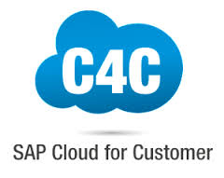
C4C perfect sales forecast: Supervised regression
Features: CRM entries, comments on sales leads
Target: revenue at quarter end

Slide 16
Supervised learning: classification
We have (x, y) examples for training
y is discrete
Learning: find {w2, w1, w0} that makes accurate prediction on training data and generalize to unseen test data
Model: y = sign(w2*x2 + w1*x1 + w0)
x2
Parameters: {w2, w1, w0}
y = h(x)
x1

Slide 17

CV matching: Supervised classification
Features: entities from the CV and job profile
Class: match or not
sFIN Fraud prediction: Supervised classification
Features: transaction and customer details
Class: fraud or not
Yaas.IO recommender: Supervised classification
Features: shopping basket and customer details
Class: customer will buy product or not

Slide 18
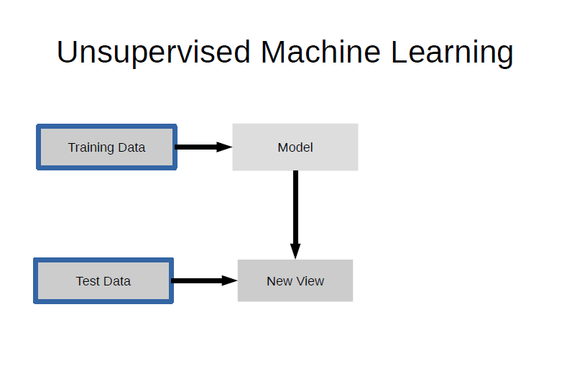

Slide 19
Unsupervised learning: clustering
We only have x examples for training
y = h(x)
Learning: find structure in the data without being told the answer
x2
x1

Slide 20
C4C social buzz clustering: unsupervised clustering
Features: documents from social media
Output: document clusters

Slide 21
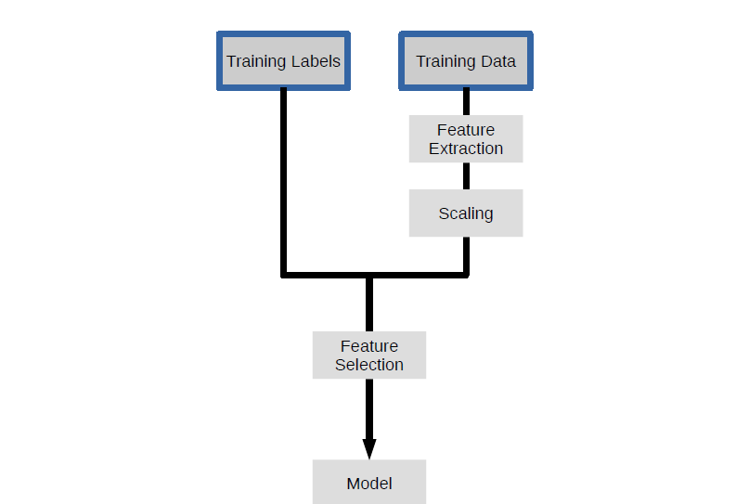

Slide 22
Production Data
Feature Extraction
Scaling
Prediction
Application

Slide 23
Recap
Machine learning: estimate a function from data
Training: optimize function parameters to data
Supervised: we have the correct answer during training
Common tasks: regression, classification, clustering

Slide 24
Where to go from here..
https://github.wdf.sap.corp/I073941/ml-bootcamp

